Slide 1
Calories predictions from continuous glucose monitors
Sai Jaideep Reddy Mure

Slide 2
Research Overview and goals
A quick overview of the project:
Data includes CGM data, Viome data, demographic data, and breakfast/lunch intake data.
Neural networks are not very effective at finding relationships across multiple data types.
What if we use different combinations of inputs?
What approaches are suitable for small and complex datasets?
What if we divide calorie estimations into separate tasks and train them individually?

Slide 3
Challenges/proposed solutions
Giving equal importance to all inputs
Complexity increases, leading to slower optimization.
Identifying critical data for the output.
Solutions Proposed
Using different architectures to combine inputs at various levels
Combining 2 inputs at the y-th hidden layer.
Merging the 3rd input at the x-th hidden layer.

Slide 4
Methodology
Different Network Approaches
Designed the 3-input model based on data type, ensuring compatibility with various data representations.
Marked an individual order for their respective loss functions to prioritize specific predictions.
Incorporated additional preprocessing steps to enhance feature extraction for each input type.

Slide 5
Proposed Diagram
Dense
L
a
Y e r
Dense l
a y e r
Denselayer
Cgm Data
output
Demo data
Img data

Slide 6
Methodology
Assigned the highest loss at the beginning and the lowest at the end in the hidden layers.
For CGM data we have used the sliding window to extract features
Optimizer used is adam
Train-validation : 90 10

Slide 7
Methodology
Needed to check on the minimizing variances between batches and balancing weights
- LibAUC: A Deep Learning Library for X-Risk Optimization Paper
changed the optimizer to LibAUC
AUCMLoss is best considered in paper but implemented NRMSRE Loss
Based on the positive samples and the negative samples the loss function is designed.

Slide 8
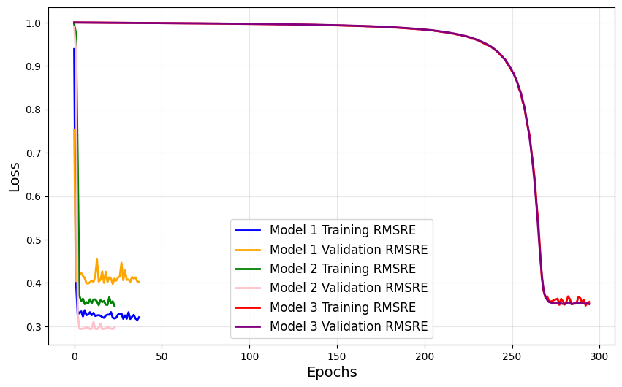
Results
Results :
Model1 : Normal Traditional(0.39) , Model2 : proposed arch(0.29), Model3 : LibAuc (0.34)

Slide 9
Discussion
Results were converged faster
Lower loss compared to traditional way
Libauc works better for the classification task
New Ideas :
Implementation of continual learning since the task were less how to make model more effective
Weight initialization strategies.
Replay and regularization methods

Slide 10
Any Questions?
Thank You

